Slide 1
Intelligence: An Introduction

Slide 2
What is Intelligence ?
The concept of intelligence has been the subject of much debate and research over the years, and different theories have emerged to explain its nature and measurement.
Intelligence can be defined as the ability to learn, understand, reason, adapt, and solve problems.
It encompasses a wide range of cognitive abilities, including perception, memory, attention, language, creativity, and reasoning.
Intelligence is not limited to any specific domain or task but is a general mental ability that allows individuals to function effectively in a variety of contexts.

Slide 3
Types of Intelligence
Emotional intelligence: Ability to recognize and understand one's own emotions and the emotions of others, and to use this information to guide thinking and behavior, e.g.,
Empathy: ability to understand and share the feelings of others, and to respond in a way that shows care and respect.
Social Intelligence: Ability to understand and navigate social situations, and to use this knowledge to build and maintain positive relationships with others, e.g.,
Persuasion and influence: ability to persuade and influence others through effective communication and interpersonal skills.
Logical-mathematical intelligence: Ability to reason logically and abstractly, and to use mathematical and scientific concepts to solve problems, e.g.,
Scientific thinking: ability to use the scientific method to gather and analyze data, and to draw valid conclusions based on evidence.

Slide 4
What is Artificial Intelligence ?
Definition:
Field of CS that focuses on creating machines that can perform tasks that would typically require human-level intelligence to complete.
Examples of tasks that AI can perform
Visual perception, speech recognition, decision-making, and language translation
How AI works:
Developing algorithms and computer programs that can learn and improve their performance over time through the use of large amounts of data and feedback mechanisms.
Potential impact of AI
Revolutionizing industries and transforming the way we live and work
Future of AI
Rapidly growing field with new advancements and applications emerging all the time.

Slide 5
What is Artificial Intelligence ?
Discipline that systematizes and automates intellectual tasks to create machines that:
Act like humans | Act rationally
Think like humans | Think rationally

Slide 6
Movie Time
How artificial intelligence will change your world in 2019, for better or worse

Slide 7
Characteristics of Intelligent Systems
Learning: Ability to improve performance based on experience
Example: A machine learning algorithm that improves its accuracy over time as it processes more data.
Adaptability: Ability to adjust to new situations
Example: An autonomous vehicle that can adjust its driving behavior based on changing road and weather conditions.
Reasoning: Ability to make decisions based on available information
Example: An expert system that suggests a treatment plan based on a patient's symptoms.
Creativity: Ability to generate new and innovative ideas
Example: A natural language generation system that can write creative and engaging stories.

Slide 8
Characteristics of Intelligent Systems
Learning: Ability to improve performance based on experience
Example: A machine learning algorithm that improves its accuracy over time as it processes more data.
Adaptability: Ability to adjust to new situations
Example: An autonomous vehicle that can adjust its driving behavior based on changing road and weather conditions.
Reasoning: Ability to make decisions based on available information
Example: An expert system that suggests a treatment plan based on a patient's symptoms.
Creativity: Ability to generate new and innovative ideas
Example: A natural language generation system that can write creative and engaging stories.

Slide 9
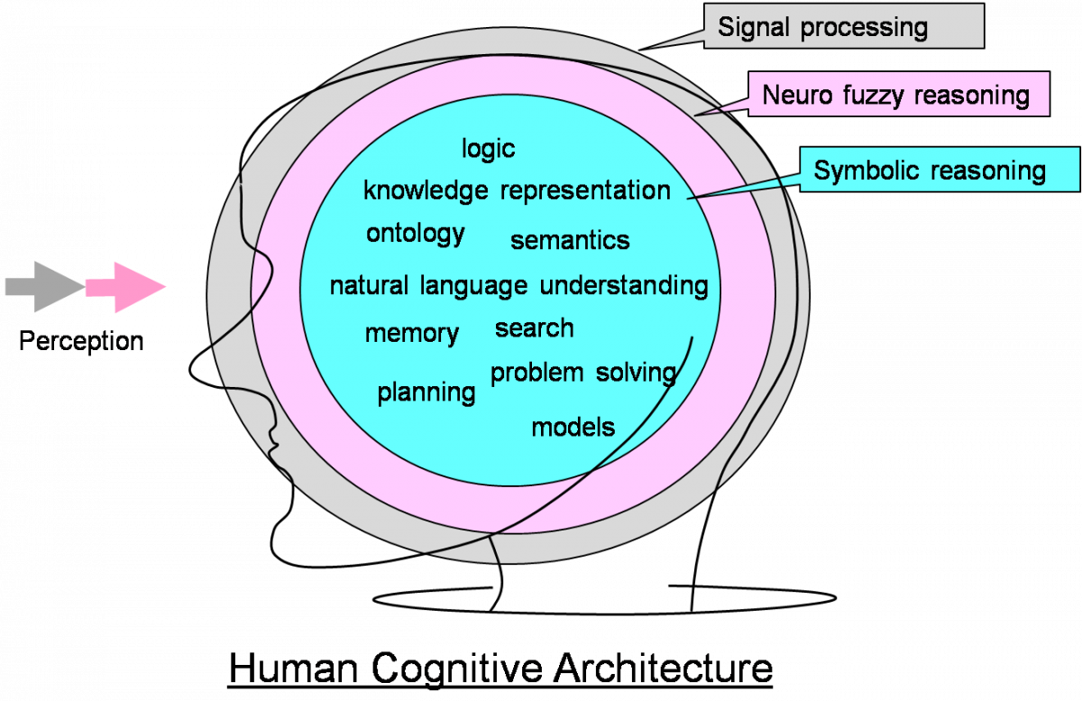
Components of an Intelligent System

Slide 10
Components of an Intelligent System
Input Interface -> Perception: Allows the user or the system to input data into the intelligent system.
Various forms such as voice commands, text input, sensor data, or images.
Knowledge Base: Stores the knowledge or information required for the system to make intelligent decisions.
The knowledge can be represented in various forms such as rules, facts, or statistical models.
Inference Engine: Uses the knowledge base to reason and make decisions based on the input data.
It applies various techniques such as deduction, induction, or abduction to draw conclusions from the available information.
Output Interface -> Execution: Presents the results or decisions of the system to the user or another system.
Various forms such as text output, visualizations, or actions performed by the system.

Slide 11
IS Components: Virtual Assistant
Input Interface: Voice commands [Hey Siri!]
Knowledge Base: User's calendar, contacts, and preferences, as well as general knowledge about the world such as weather forecasts, news headlines, or restaurant reviews.
Inference Engine: Applies various techniques such as natural language processing, machine learning, and rules-based reasoning to understand the user's input and provide appropriate responses.
For example, if the user asks "What's the weather like today?"
the system might use speech recognition to transcribe the question,
parse the text to extract the relevant keywords ("weather", "today"), and
query a weather service to retrieve the forecast for the user's location.
Output Interface: Speech
"The forecast for today is sunny with a high of 28 degrees"

Slide 12
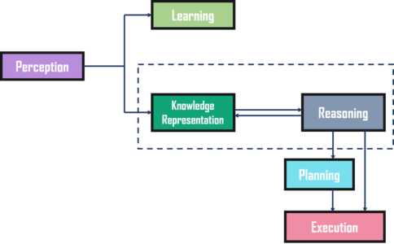
Components of an Intelligent System

Slide 13
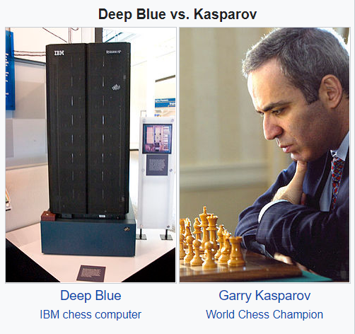
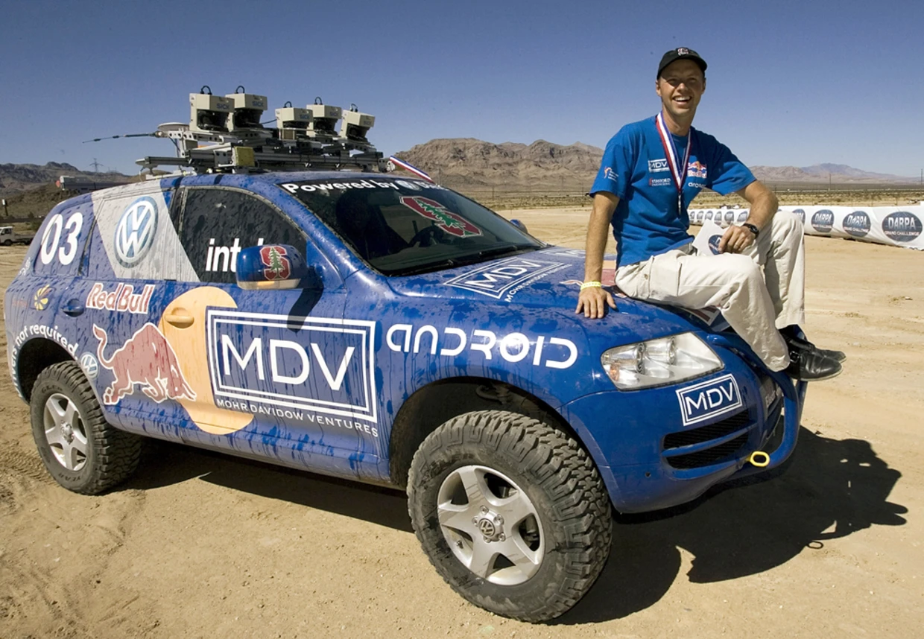
Most Amazing Milestones So Far
1997 – Deep Blue defeats world chess champion Garry Kasparov
2005 – The DARPA Grand Challenge
A $2 million prized race for autonomous vehicles across 100+ kms off-road terrain in the desert.
Stanford Racing Team's leader Sebastian Thrun

Slide 14
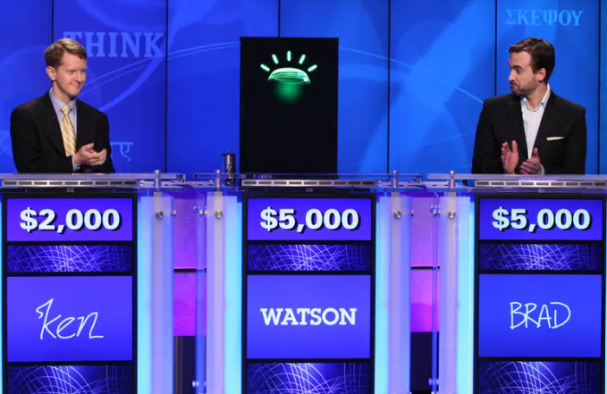
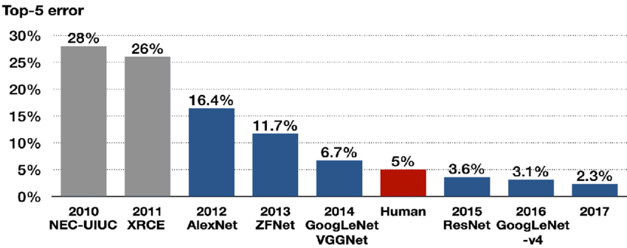
Most Amazing Milestones So Far
2011 – IBM Watson’s Jeopardy! Victory
The final tally was $77,147 to Mr. Jennings’s $24,000 and Mr. Rutter’s $21,600.
2015 – Machines “see” better than humans
Largescale image recognition contest for classifying 50,000 high-resolution color images into 1,000 categories.
The model is considered to have classified a given image correctly if the target label is one of the model’s top 5 predictions.

Slide 15
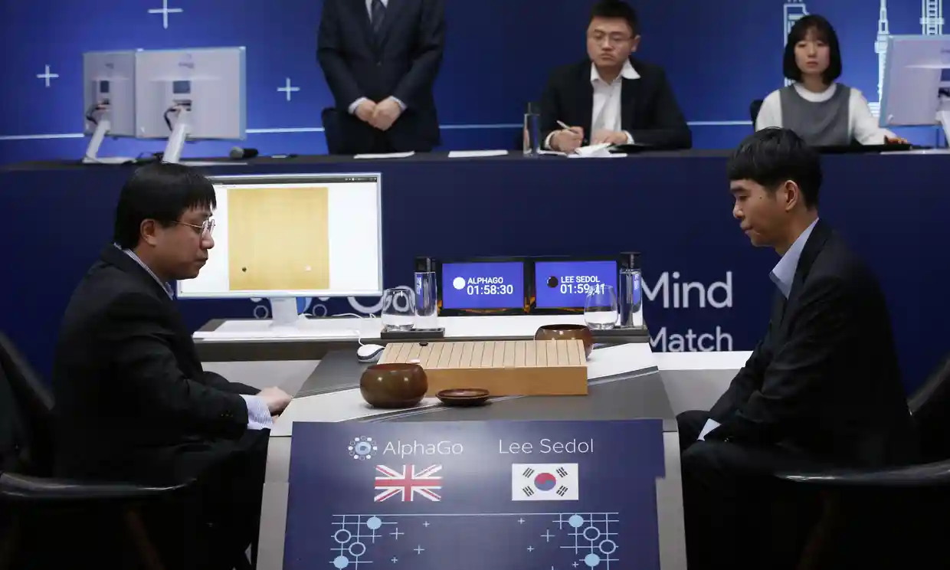
Most Amazing Milestones So Far
2016 – AlphaGo created by Deep Mind (now a Google subsidiary) defeated world Go champion Lee Sedol over five matches.
There are over 100,000 possible opening moves in Go, compared to 400 in Chess, make the brute force approach impractical.

Slide 16
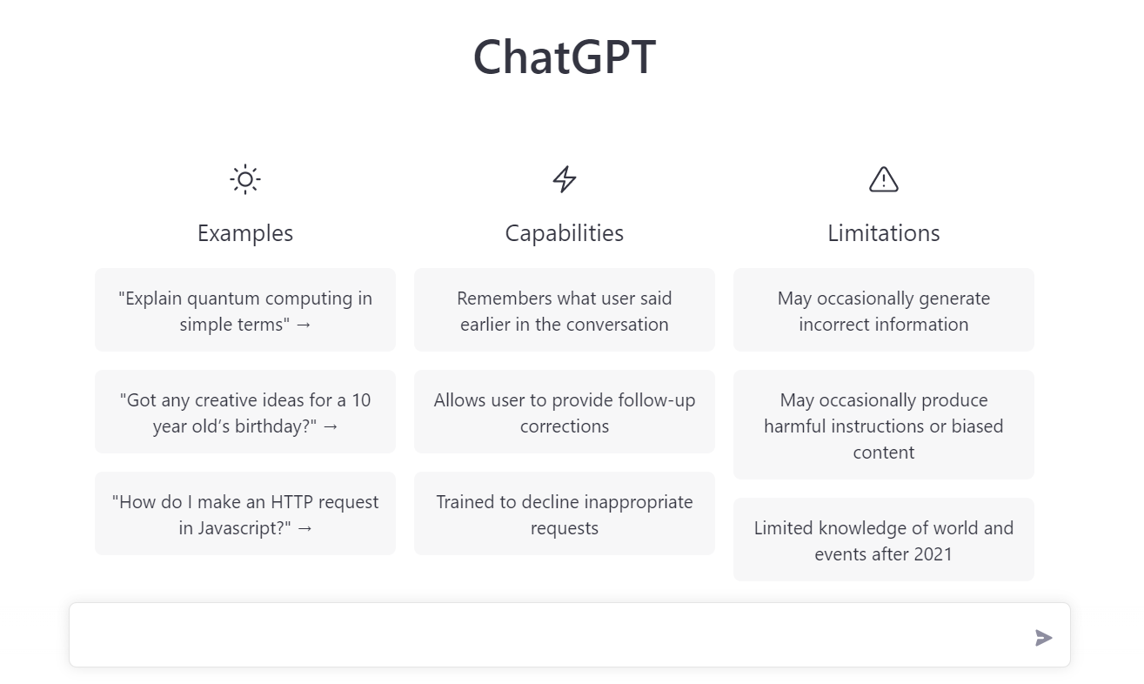
Most Amazing Milestones So Far
2020 – OpenAI created third iteration of the GPT (Generative Pre-trained Transformer) series of language models.
Ability to understand and generate human-like language, making them useful for a wide range of applications such as language translation, content creation, and customer service.
Advanced natural language processing techniques, deep learning, and massive amounts of training data to continuously improve their language skills.

Slide 17
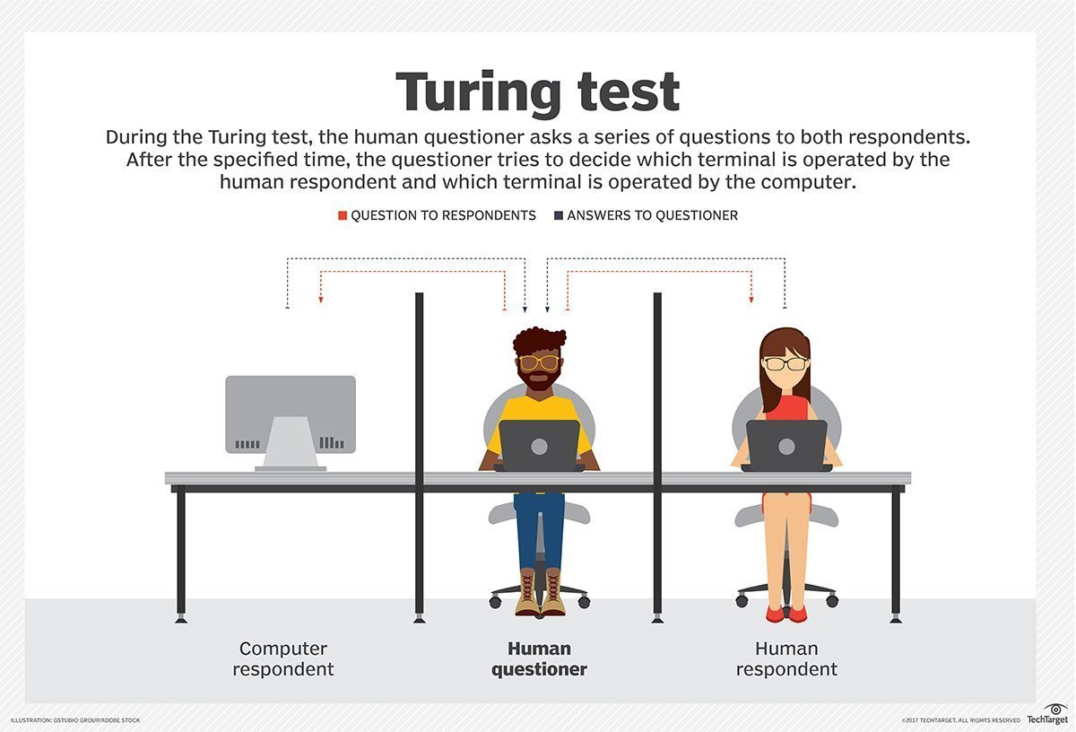
Turing Test
Is Turing Test the right goal?
“Aeronautical engineering texts do not define the goal of their field as
making ‘machines that fly so exactly like pigeons that they can fool
even other pigeons.’” [Russell and Norvig]

Slide 18
Advantages of IS
Efficiency: IS can process vast amounts of data and information quickly and accurately, reducing the time and effort required for complex tasks.
They can automate repetitive and mundane tasks, freeing up human workers to focus on more creative and strategic tasks.
They can also work 24/7 without breaks or rest, providing continuous and uninterrupted service.
Example: A customer service chatbot that can handle multiple inquiries simultaneously without waiting times, reducing the need for humans.
Accuracy: IS can perform tasks with a high degree of precision and accuracy, reducing errors and improving overall quality.
They can also analyze data and information more objectively and consistently than humans, who may be subject to biases or variations.
Example: A fraud detection system that can analyze transaction data and detect anomalies or suspicious patterns, reducing the risk of financial losses.

Slide 19
Advantages of IS
Cost-effectiveness: IS can often perform tasks at a lower cost than human workers, especially for tasks that are repetitive or require specialized knowledge or skills.
They can also reduce the need for physical space and infrastructure, as well as lower the risk of human error and associated costs.
They can also help organizations make better decisions by providing accurate and timely insights, which can lead to cost savings or revenue growth.
Example: A supply chain optimization system that can analyze logistics data and suggest optimal routes and schedules, reducing transportation costs and improving delivery times.

Slide 20
Worries about AI
Job displacement: AI may automate many jobs, leading to unemployment or underemployment.
Example: Self-driving vehicles may lead to job displacement for human drivers, such as taxi and truck drivers.
Bias and discrimination: AI may perpetuate or amplify biases in society, leading to unfair treatment of certain groups.
Example: Facial recognition systems have been shown to have higher error rates for people with darker skin tones, leading to potential bias and discrimination.
Privacy and security: AI may collect, use, or misuse personal data, putting individuals and organizations at risk.
Example: Social media companies may use AI to collect and analyze user data for targeted advertising, raising concerns about privacy and data protection.

Slide 21
Worries about AI
Autonomy and control: AI may make decisions or take actions without human oversight or intervention, raising concerns about accountability and responsibility.
Example: Autonomous weapons systems may make decisions to use lethal force without human intervention, raising concerns about accountability.
Misuse and abuse: AI may be used for malicious purposes, such as cyber attacks, surveillance, or warfare.
Example: Deepfake technology can be used to create convincing fake videos or images, raising concerns about the potential for misuse and abuse.
Human-AI interaction: AI may change the way humans interact with each other and with technology, raising questions about social norms, ethics, and values.
Example: Chatbots and virtual assistants may change the way we communicate

Slide 22
Worries about AI
Dependence and addiction: AI may become so integral to our lives that we become dependent or addicted to it, leading to negative consequences for mental and physical health.
Example: Social media algorithms may be designed to keep users engaged and addicted to the platform, leading to potential negative impacts on mental health and well-being.
Regulation and governance: AI may require new laws, regulations, and ethical frameworks to ensure its safe and responsible development and use.
Example: Governments and regulatory bodies may need to develop new regulations and ethical guidelines to ensure that AI is developed and used in a safe and responsible manner.

Slide 23


Slide 24
References and Suggested Readings
Theory of multiple intelligences: https://www.niu.edu/citl/resources/guides/instructional-guide/gardners-theory-of-multiple-intelligences.shtml
https://www.technologyreview.com/2023/12/19/1084505/generative-ai-artificial-intelligence-bias-jobs-copyright-misinformation/

